Slide 1


Kettering
Association for
Computing Machinery
Link tree QR Code Here
Meeting 4
Notes:
Agenda
Survey & Food - 12:20 - 12:35
Ice breakers - 12:35 - 12:45
Introduction - 12:45 - 1:00
Q & A: 1:00 - 1:05

Slide 2


Ice Breakers
WORKSHOP

Slide 3
CONTENTS
Application Introduction
Application Structure
Back End with Spring Boot
Layers of Spring Boot Application
Application Implementation
Initialize Spring Boot Project
Connect MySQL
Student Class Implementation
Student Repository Implementation
Custom Exception Implementation
Student Service Implementation
Student Controller Implementation
Running Application

Slide 4
Ice Breakers
APPLICATION INTRODUCTION

Slide 5
STUDENT DATABASE
The application we are implementing for the Spring Boot workshop is a student database
Features:
Add a student to student database
Modify a student in student database
Delete a student in student database
Get all of the students in the student database

Slide 6
APPLICATION STRUCTURE
Frontend
Terminal
Backend
Sprint Boot
Database
MySQL

Slide 7
STUDENT DATABASE
What is Spring Boot?
A tool that provides the framework and template for stand-alone applications
It has a lot of support for different uses and has a lot of resources
Why we are using Spring Boot?
Spring Boot is widely used for backend implementation in big and small companies including Ford
Java is a commonly known language with a moderate learning curve

Slide 8
SPRING BOOT LAYERS
Frontend
Controller
Service/Business
Repository
Database

Slide 9
SPRING BOOT LAYERS
Controller
Contains the methods that can be called from the frontend
Service
Does all the calculations and indirectly adds data to the database
Repository
Adds the data from the service layer to the database

Slide 10
Ice Breakers
APPLICATION IMPLEMENTATION

Slide 11
WHAT YOU NEED
You need to install the following software. Due to time constraints, this presentation will not show how to do so
IntelliJ or another IDE
Java Development Kit (JDK)
Apache Maven
MySQL Workbench and Server
Postman

Slide 12
INITIALIZE SPRING BOOT
Navigate to https://start.spring.io/
Input the following
Project: Maven
Language: Java
Dependencies: Spring Web
Generate project
Download and unzip generated folder in desired location

Slide 13
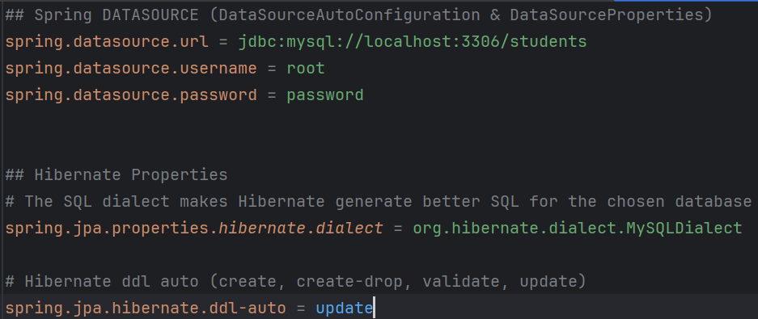
CONNECT MySQL
1. Add the following to the application.properties file found under the Resources folder

Slide 14
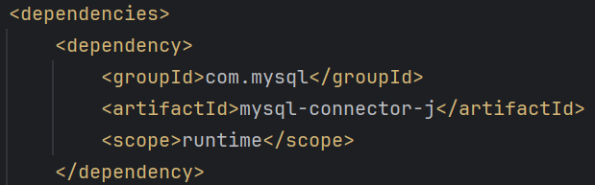
CONNECT MySQL
2. Add the following to the pom.xml file under the dependencies tag

Slide 15
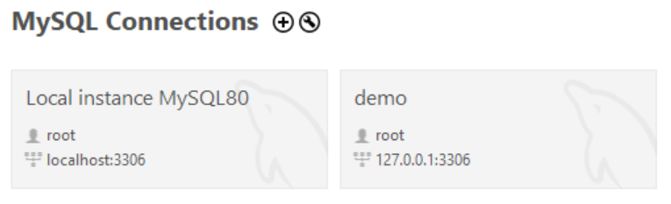
MAKE THE DATABASE
In MySQL Workbench, click the + icon next to MySQL Connections
Enter a connection name and click OK

Slide 16
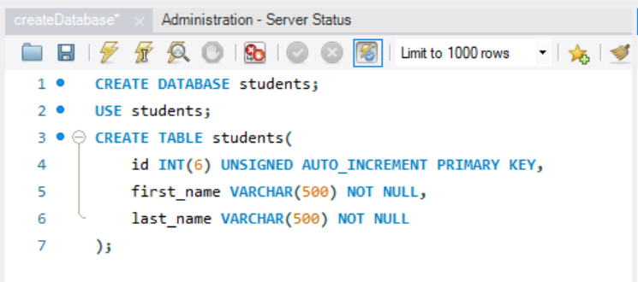
MAKE THE DATABASE
In the new connection, enter the following queries and execute by clicking the lightning bolt icon

Slide 17
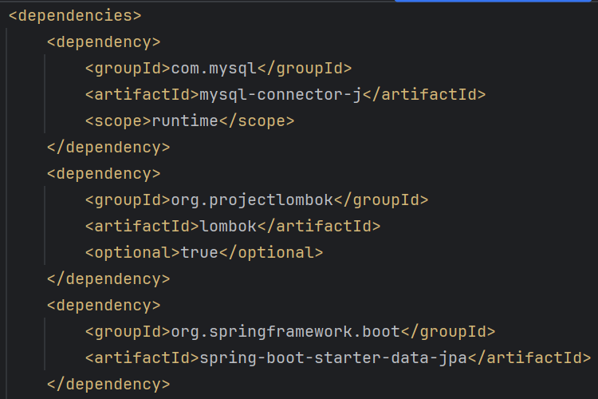
POM FILE
Add the following dependencies in the pom.xml file:

Slide 18
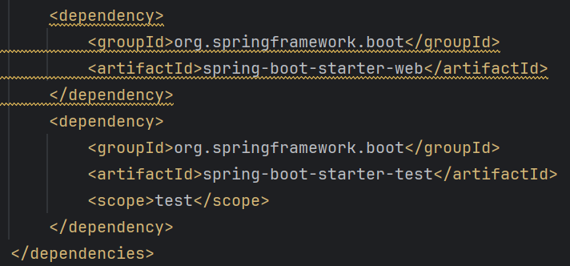
POM FILE
(continued)

Slide 19
STUDENT CLASS
In IntelliJ, make a new folder/package titled “student” under the com folder
Add a file called “Student.java”

Slide 20
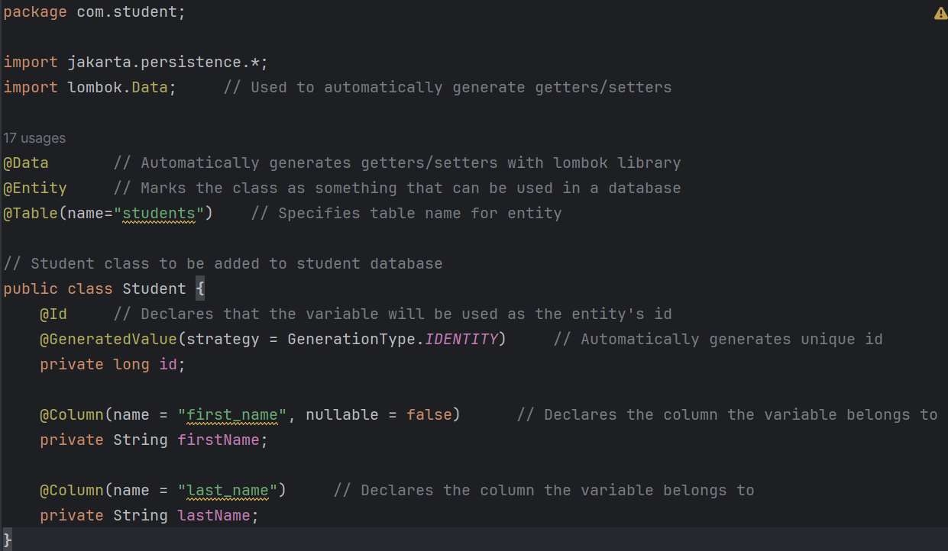
STUDENT CLASS
Enter the following in “Student.java”

Slide 21
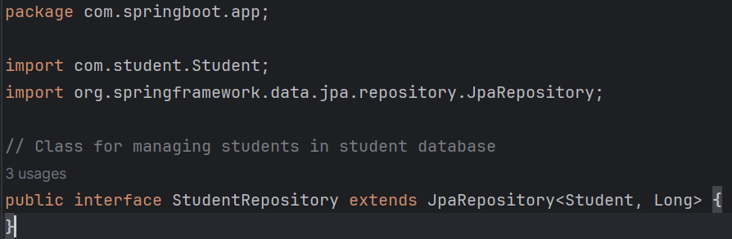
STUDENT REPOSITORY
Under the springboot.app folder, make a file called “StudentRepository.java”

Slide 22
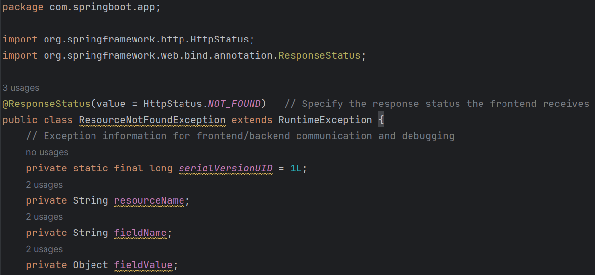
CUSTOM EXCEPTION
Under the same springboot.app folder, make another file called “ResourceNotFoundException.java”

Slide 23
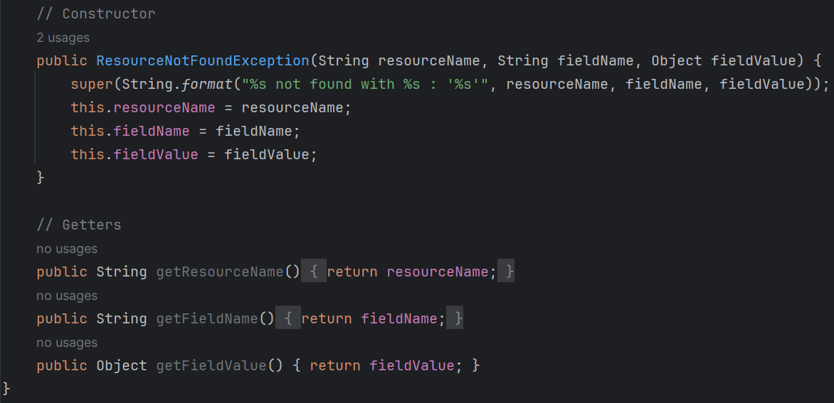
CUSTOM EXCEPTION
(continued)

Slide 24
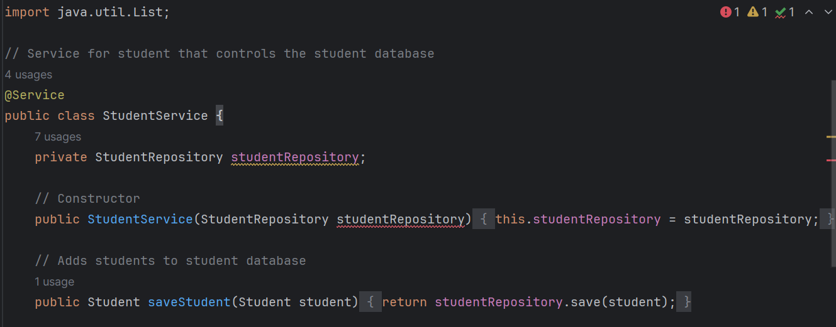
STUDENT SERVICE
Under the com folder, make a folder named “service” and add a file called “StudentService.java”

Slide 25
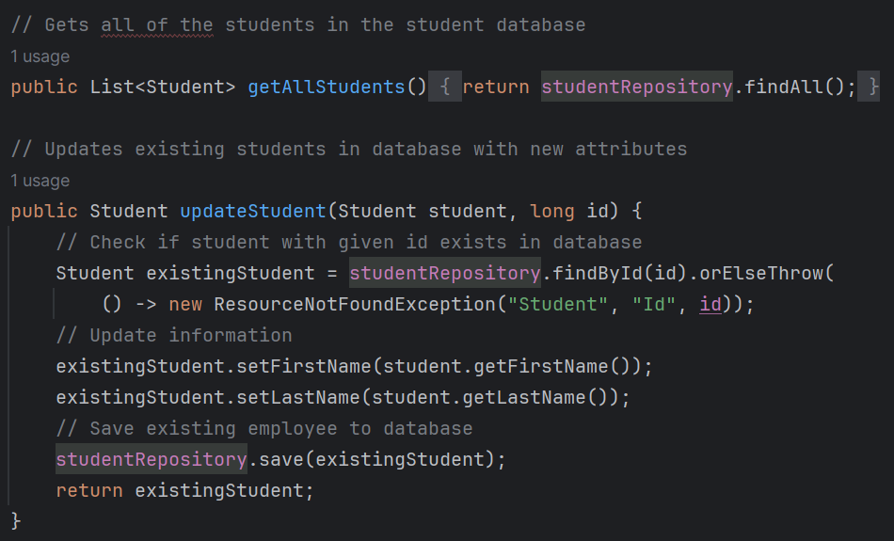
STUDENT SERVICE
(continued)

Slide 26
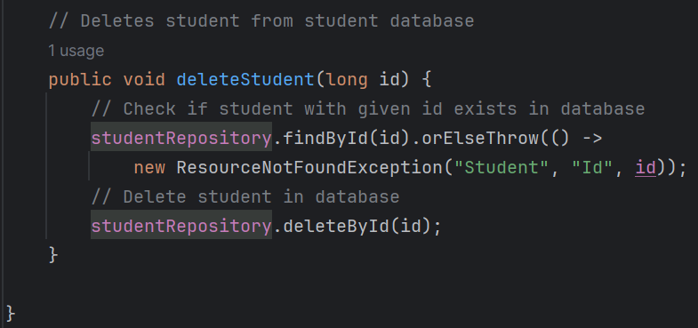
STUDENT SERVICE
(continued)

Slide 27
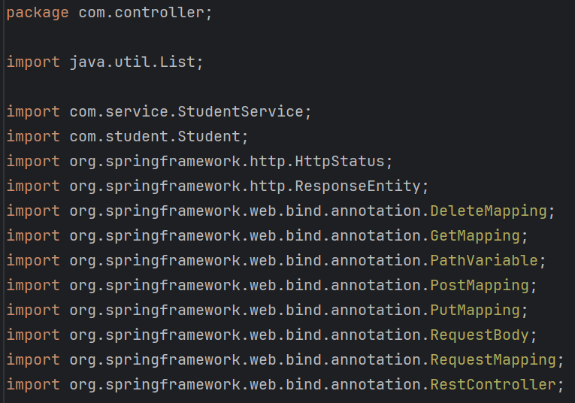
STUDENT CONTROLLER
Under the com folder, make a folder named “controller” with the file “StudentController.java”

Slide 28
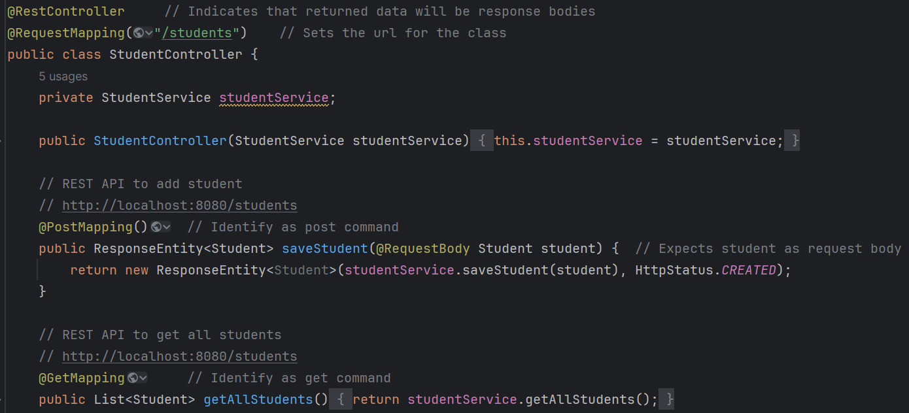
STUDENT CONTROLLER
(continued)

Slide 29
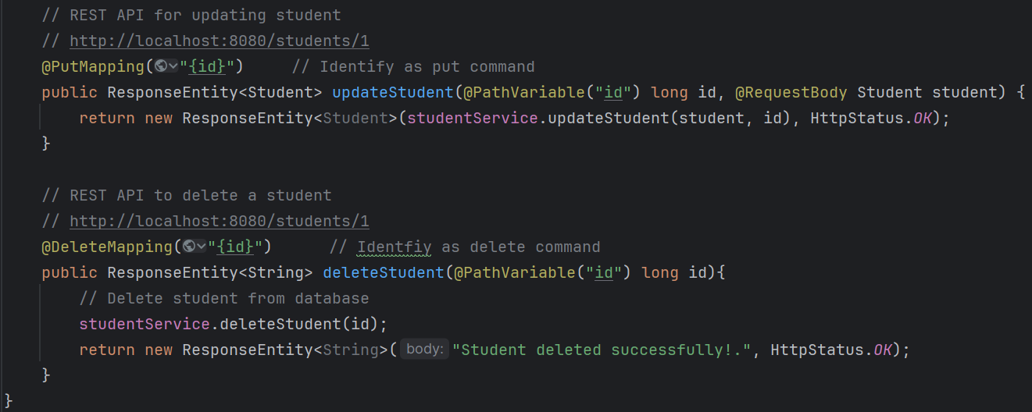
STUDENT CONTROLLER
(continued)

Slide 30
HTTP REQUEST METHODS
HTTP Request Methods tell the backend what action is being taken when modifying databases
Although there are more HTTP Request Methods, here are the most common:
POST - add entry
PUT - modify entry
DELETE - delete entry
GET - get entry

Slide 31
Ice Breakers
RUNNING THE APPLICATION

Slide 32
Ice Breakers
TERMINAL

Slide 33
RUNNING THE APPLICATION
To run, type the following in the application terminal:
mvn clean spring-boot:run
This runs the application in your local host (default is 8080)
To see the students, type:
curl -v localhost:8080/students
The output will be an array of students in JSON format
Notes:
mvn org.springframework.boot:spring-boot-maven-plugin:run

Slide 34
ADDING/EDITING STUDENTS
To add and modify a student, type:
curl -X <POST/PUT> localhost:8080/students</id> -H 'Content-type:application/json' -d '{"firstName": "<first>", "lastName": "<last>"}'
Where <POST/PUT> is POST or PUT, </id> is the id of the student being modified, and <first> and <last> are the first and last names for the student
POST adds a new student
PUT modifies student

Slide 35
ADDING/EDITING STUDENTS
Adding a student example:
curl -X POST localhost:8080/students -H 'Content-type:application/json' -d '{"firstName": "John", "lastName": "Doe"}'
Modifying a student example:
curl -X PuT localhost:8080/students/1 -H 'Content-type:application/json' -d '{"firstName": "Jill", "lastName": "Doe"}'

Slide 36
DELETING A STUDENT
To delete a student, type:
curl -X DELETE localhost:8080/students/<id>
Where <id> is the id of the student to be deleted

Slide 37
Ice Breakers
INTELLIJ + POSTMAN

Slide 38
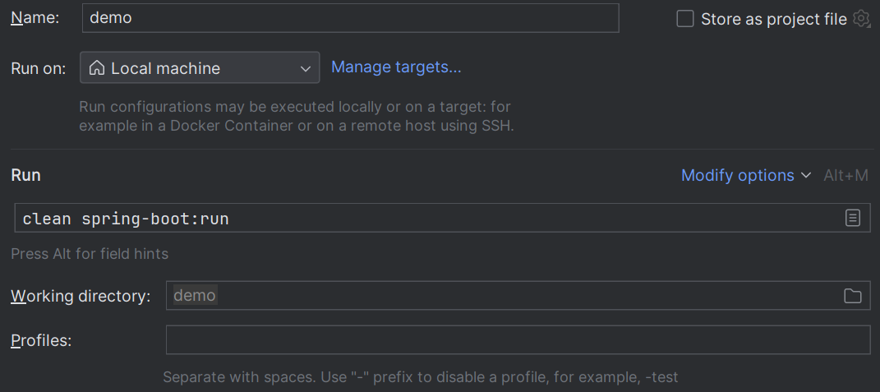
RUNNING THE APPLICATION
Open run configurations in IntelliJ and enter the following in the command line input
clean spring-boot:run
Run the configuration

Slide 39
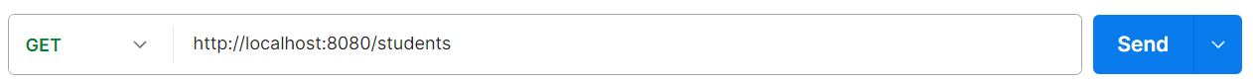
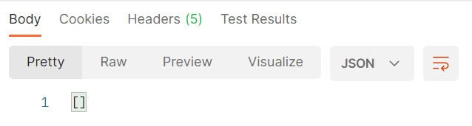
GETTING THE STUDENTS
In Postman, make a new tab, set it to GET, and enter the following:
http://localhost:8080/students
Click send to see the students in the database (will be an empty list)

Slide 40
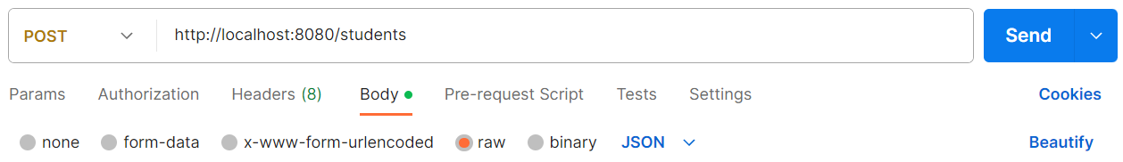
ADDING A STUDENT
In Postman, make a new tab, set it to POST, and enter the following:
http://localhost:8080/students
Under the Body tab, click the raw radio button and change the blue dropdown from text to JSON

Slide 41
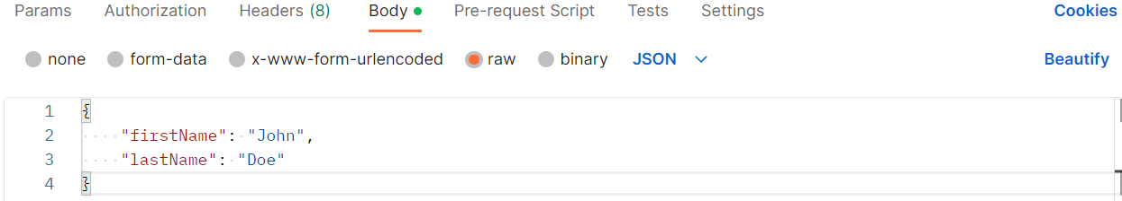
ADDING A STUDENT
In the body, type:
{"firstName": "John", "lastName": "Doe"}
Click send to add a new student named John Doe

Slide 42
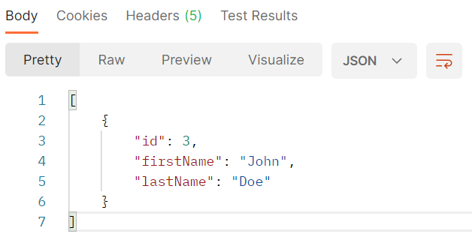
SEEING THE ADDED STUDENT
If you run the GET request again, you will see that John Doe has been added to the students database:

Slide 43
EDITING THE STUDENT
Duplicate the POST tab to copy over the JSON body and URL. Then, add the id of the new student (3 is used as an example):
http://localhost:8080/students/3
Change the request to PUT
Modify the JSON body to the new first and/or last name:
{"firstName": "Jill", "lastName": "Doe"}

Slide 44
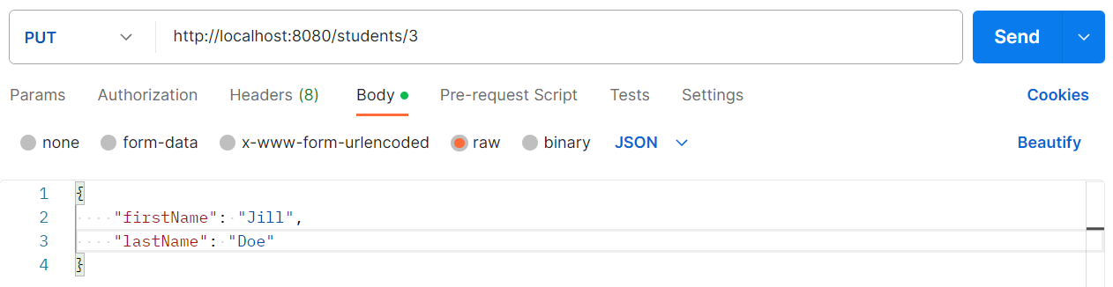
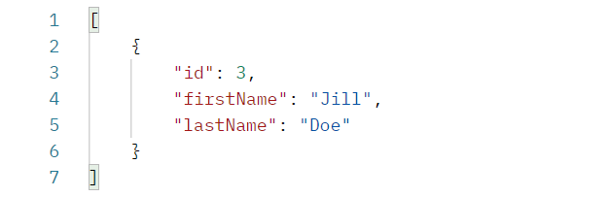
EDITING THE STUDENT
Click send to edit the student
Go back to the GET tab and send the GET request again to see the changes

Slide 45
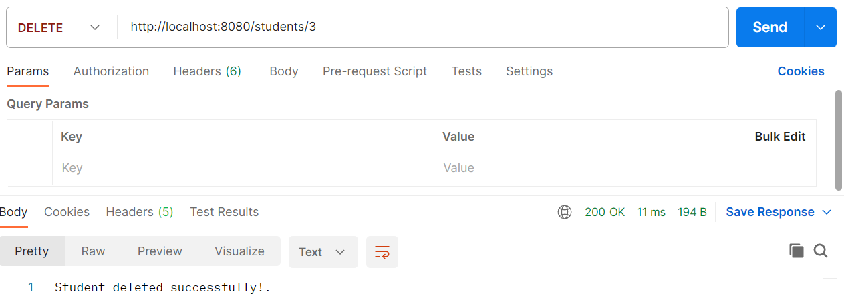
DELETING THE STUDENT
Make a new tab and enter the same URL used to edit the student in the POST request:
http://localhost:8080/students/3
Change the request to DELETE and send the request to delete the student

Slide 46
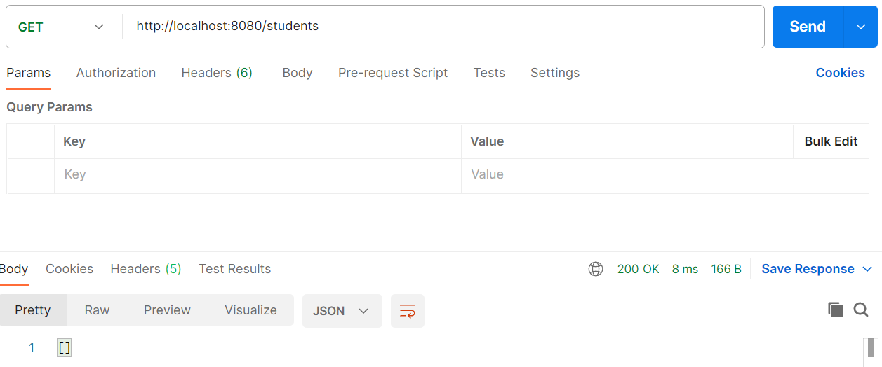
SEEING THE DELETED STUDENT
Run the GET request once more to see the student deleted

Slide 47
Ice Breakers
FURTHER LEARNING

Slide 48
TOPICS NOT COVERED
Not all topics could be covered, but for more useful information, we recommend to look into the following:
Spring Boot unit testing
Frontend/Backend communication
Communication testing with Postman
Gradle and Maven
Offered Spring Boot dependencies and builds

Slide 49
WORKS CITED
https://www.javaguides.net/2021/07/spring-boot-tutorial-for-beginners.html

